Slide 1

Assembly Language
* Created with contributions by Myrto Papadopoulou and Frank Plavec.

Slide 2

Programming the processor
Things you’ll need to know:
Control unit signals to the datapath
Machine code instructions
Assembly language instructions
Programming in assembly language

Slide 3
How things fit together
Assembly Language
converted to
Machine Code
extract first 6 bits
Opcode
input to
Control Unit
produces
Datapath Signals

Slide 4
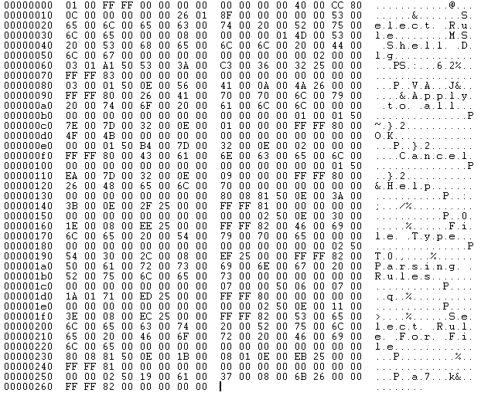
Machine Code Instructions

Slide 5
Intro to Machine Code
Now that we have a processor, operations are performed by:
The instruction register:
Sending instruction components to the processor.
The control unit:
Based on the opcode value (sent from the instruction register), sending a sequence of signals to the rest of the processor.
Only questions remaining:
Where do these instructions come from?
How are they provided to the instruction memory?
Notes:
Before moving on to the next slide, it’s good to pick somebody and ask them how they would create a new, low-level language that takes care of some basic register operations. For example, what would be a good name for an addition operation? After somebody says “add” and that’s written to the board, ask about the order in which you’d list the registers being operated on. After months of Verilog, the suggestion is usually destination, then sources. Which leads to the next slide ☺

Slide 6
Assembly language
Each processor type has its own language for representing, say 32-bit, instructions as user-level code words.
Example: C = A + B
Assume A is stored in $t1, B in $t2, C in $t3.
Assembly language instruction:
Machine code instruction:
Note: There is a 1-to-1 mapping for all assembly code and machine code instructions!
add $t3, $t1, $t2
000000 01001 01010 01011 XXXXX 100000
Notes:
This provides one of the final links between the processor and the programmer, even though there’s not much to it. It’s important to emphasize that the assembly instruction is something that we can recognize and understand, and the machine code instructions is what the computer understands, and translating between the two is a simple 1-to-1 mapping.

Slide 7
Encoding the instruction
Machine code instructions contain all the details about a processor operation, such as:
What operation is being performed (opcode),
What registers are being used in this operation,
What other information might be needed to make this operation happen (immediate or shift values)
When we write (or interpret) a machine code instruction, we need to know how to encode (or decode) these details into these 32 bits.

Slide 8
R-type instructions
For instance, how do we encode the earlier instruction that adds registers $t1 and $t2 and stores the result into register $t3?.
e.g.
add $t3, $t1, $t2
000000
100000
01001
01010
01011
000000 01001 01010 01011 XXXXX 100000

Slide 9
Operating on Registers
The add instruction is one of many operations that processes two register values and stores the result in a third.
This is called an R-type instruction.
Any operations whose inputs and outputs are all registers are called R-type, even if they involve less than three registers.
e.g. the jr instruction, which we get to later.
In order to encode R-type instructions, we need to know the 5-bit codes used to refer to our input and output registers.

Slide 10

Machine code + registers
MIPS is register-to-register.
Almost all operations rely on register data.
MIPS provides 32 registers (with numerical and label names).
Some have special values:
Register $0 ($zero): value 0 -- always.
Register $1 ($at): reserved for the assembler.
Registers $28-$31 ($gp, $sp, $fp, $ra): memory and function support
Registers $26-$27: reserved for OS kernel
Some are used by programs as functions parameters:
Registers $2-$3 ($v0, $v1): return values
Registers $4-$7 ($a0-$a3): function arguments
Some are used by programs to store values:
Registers $8-$15, $24-$25 ($t0-$t9): temporaries
Registers $16-$23 ($s0-$s7): saved temporaries
Also three special registers (PC, HI, LO) that are not directly accessible.
HI and LO are used in multiplication and division, and have special instructions for accessing them.
Notes:
Good to talk about how 32 registers are far more than what’s needed for the most complicated operation, so it’s okay for the processor to reserve a bunch of them for specialized functions. Make sure to draw attention to the equivalence between using $0 and $zero, $8 and $t0, because that will come in handy later when doing the assembly->machine code translation. Also take a moment to talk about the stack pointer and the return address, because they are needed later.

Slide 11
Filling in the blanks
In our previous example, registers $t1 and $t2 are registers 9 and 10 respectively, and register $t3 is the register number 11.
The registers for this instruction are encoded as 01001 ($t1), 01010 ($t2) and 01011 ($t3).
add $t3, $t1, $t2
000000
100000
01001
01010
01011

Slide 12
I-type instructions
I-type instructions also operate on registers, but involve a constant value as well.
This constant is encoded in the last 16 bits of the instruction.
e.g.
addi $t2, $t1, 42
001000
01001
01010
0000000000101010
001000 01001 01010 0000000000101010

Slide 13
J-type instructions
J-type instructions jump to a location in memory encoded by the last 26 bits of the instruction (everything but the opcode).
This location is stored as a label, which is resolved when the assembly program is compiled.
More later on how these 26 bits store jump addresses.
e.g.
j main
Note: In this example, main translates to the address below.
000010
00000000000000011000101010
000010 00000000000000011000101010

Slide 14

Review: MIPS instruction types
R-type:
I-type:
J-type:
opcode
rs
rt
rd
shamt
funct
6
5
5
5
5
6
opcode
rs
rt
immediate
6
5
5
16
opcode
address
6
26
Notes:
2^5 = 32 registers.

Slide 15
Machine code details
Things to note about machine code:
R-type instructions have an opcode of 000000, with a 6-bit function listed at the end.
Although we specify “don’t care” bits as X values, the assembly language interpreter always assigns them to some value (like 0).
It’s possible to program your processor with machine code, but makes more sense to use an equivalent language that is more natural (for humans, that is).

Slide 16
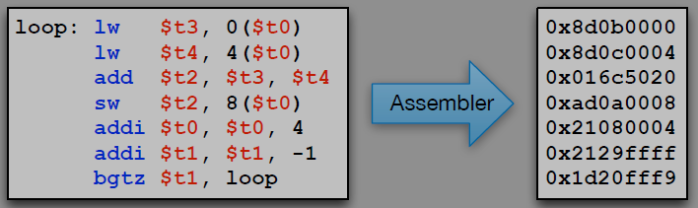
Assembly Language Overview

